Slide 1


Mediated Social Interpersonal Communication Evidence-based Understanding of Multimedia Solutions for Enriching Social Situational Awareness
CUbiC
CENTER FOR COGNITIVE UBIQUITOUS COMPUTING
Sreekar Krishna
Committee:
Dr. Sethuraman (Panch) Panchanathan, Chair
Dr. Baoxin Li Dr. Michelle (Lani) Shiota
Dr. Gang Qian Dr. John Black
ARIZONA STATE UNIVERSITY

Slide 2
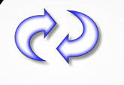
Scope of this dissertation
Multimedia Technologies
Interactions between individuals
Physically isolated.
Sensory deprived.
Sensory overload.
Communication breakdown.
Evidence-based understanding of the multimedia social interaction enrichment

Slide 3
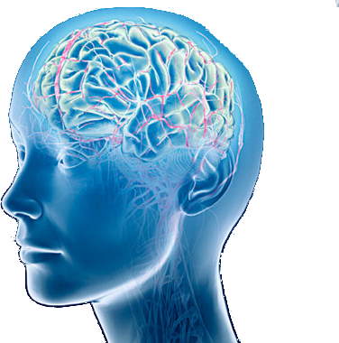
Social Interactions
Social Situational Awareness
Face
Body
Social Cognition
Social Reciprocation
Social Hearing
Voice
Social Sight
Social Touch
Social Stimulation
Social Stimulation
Social Cognition
Social Reciprocation

Slide 4
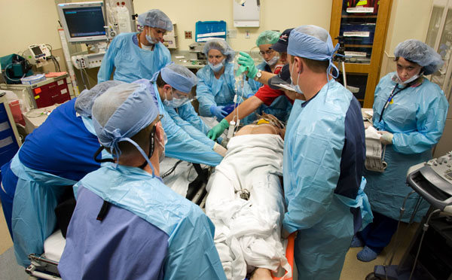
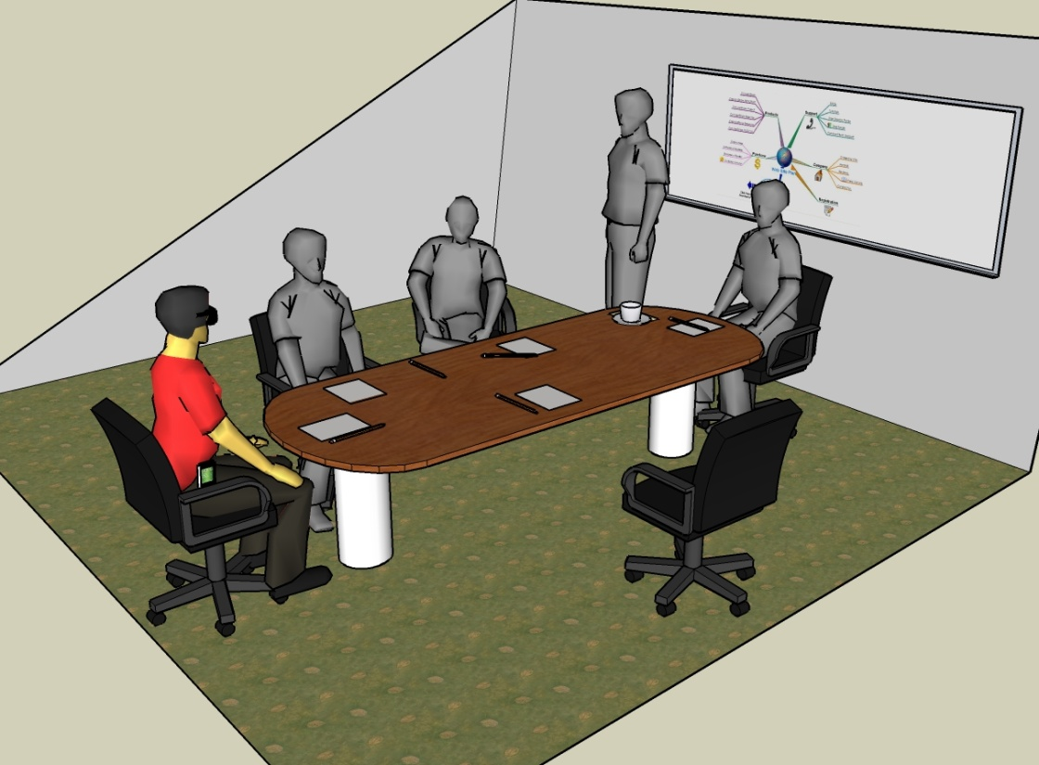
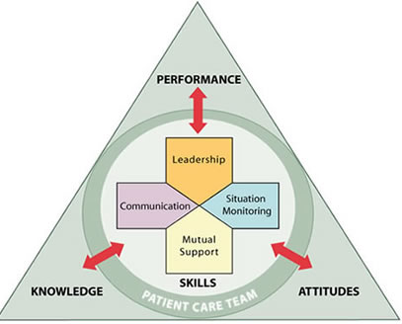
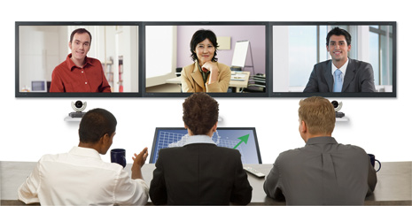
SSA in Various Settings
Social Assistance
Decision Making
Remote Collaborations
TeamSTEPPS
How many people?
Where are they located?
What are their facial expressions?
Eye Gaze
Eye Contact
Body Mannerisms
Expressing Opinion
Managing Conflict
Making Decision
Speed of Decision
Interaction with Colleagues
Difficulty Establishing Rapport
Leadership
Mutual Support
Communication
Attitude
Situation Monitoring
Patient Safety

Slide 5
Case Studies of People who are Blind
Sara
Jindal-Snape
CUbiC open focus group
Studies on a college student’s interaction with technology
8 important factors identified
Most important dimension was sociability with visual community
Studies with children who are blind
Difficulty in learning due to lack of social feedback
Important to provide assistance and rehabilitation
“It would be nice to walk into a room and immediately get to know who are all in front of me before they start a conversation”.
One young man said, “It would be great to walk into a bar and identify beautiful women”.

Slide 6
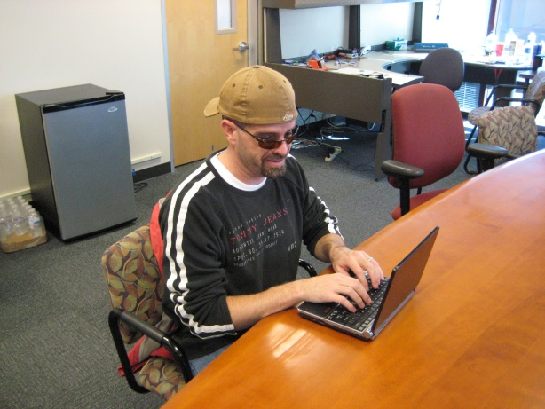
Self-Report Importance of Non-Verbal Cues
Focus Group on 8 Social needs
27 participants - 16 blind, 9 low vision and 2 sighted specialists.

Slide 7
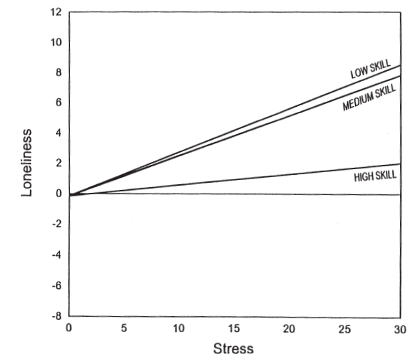
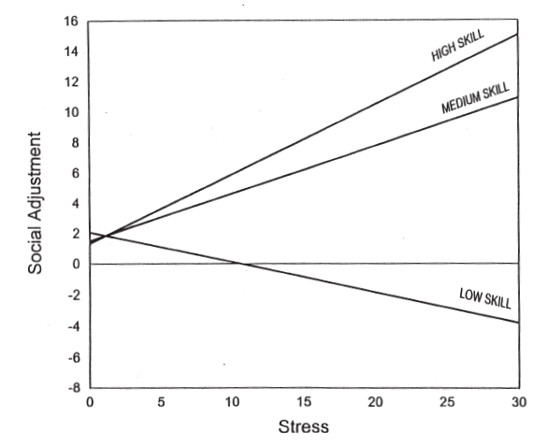
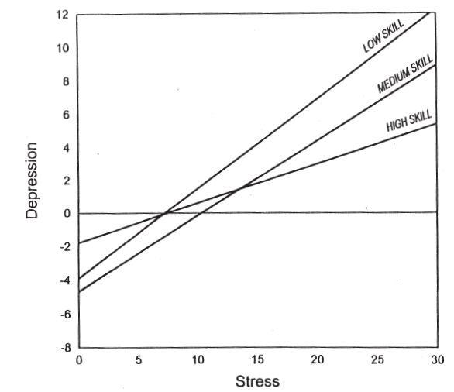
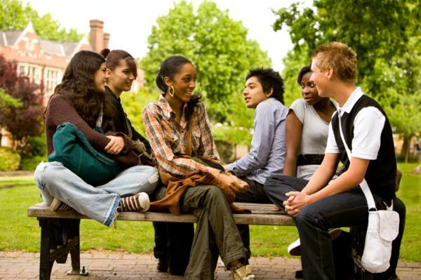

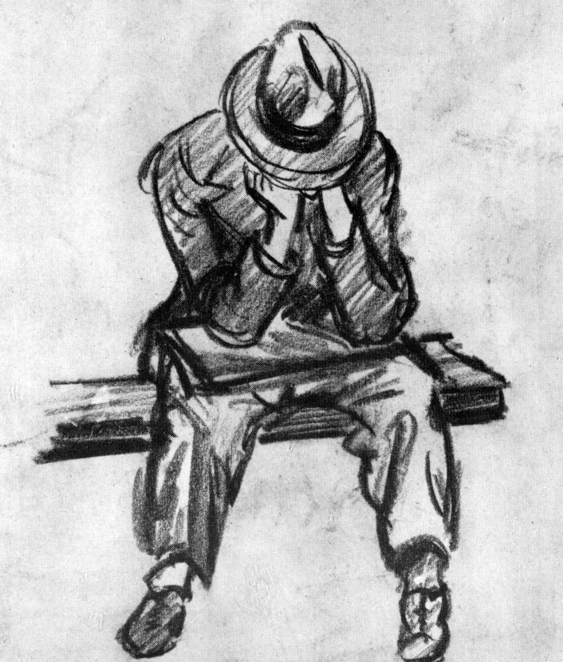

Importance of Social Skills
Loneliness
Social Adjustment
Depression
Social Skills
Verbal
Nonverbal
Skill in
Verbal expression
Verbal fluency
Initiating conversation
Skill in communicating
Affect
Attitude
Status
Emotion
The Work and Social Adjustment Scale
UCLA Loneliness Scale
Beck Depression Inventory
CENTER FOR COGNITIVE UBIQUITOUS COMPUTING

Slide 8
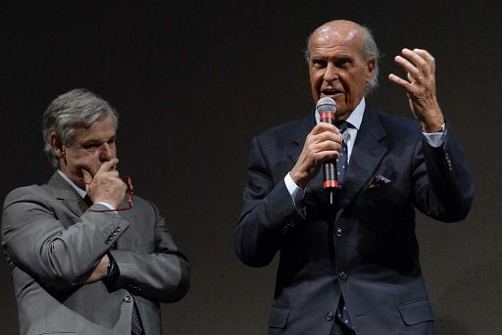
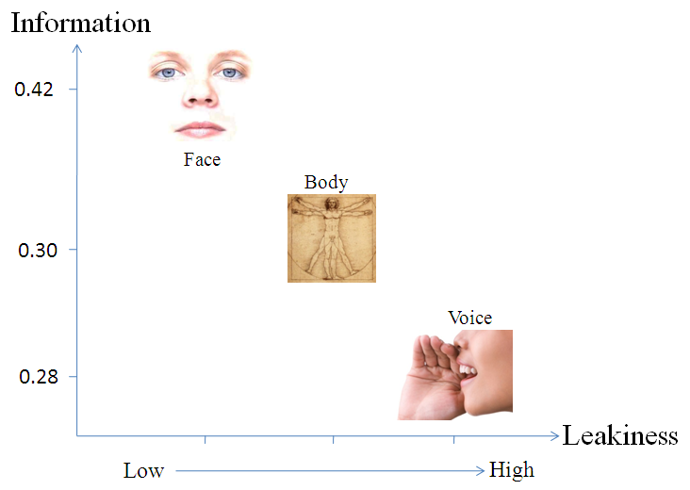
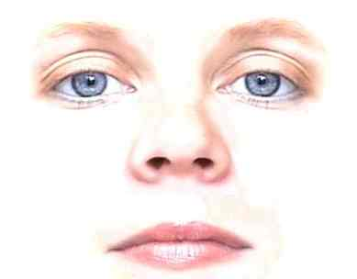
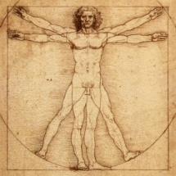
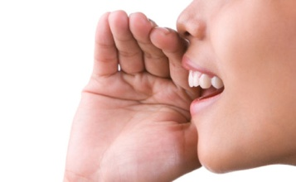
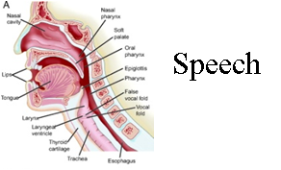
Non Verbal Cues
Enactor - Encoding
Recipient - Decoding
Face
Non Verbal
Verbal
Visual (46%)
Non-verbal (65%)
Body
Voice
Audio (54 %)
Verbal
65%
Verbal (35%)
Face and Body
Nonverbal
Prosody
Speech
CENTER FOR COGNITIVE UBIQUITOUS COMPUTING

Slide 9
Visual Non-Verbal Cues in Communication
Sensory Deficit
Visual Impairment
Blindness
Low Vision
Communication Environment
Physical Attributes of the Partner
Behavior of the partner
Familiarity of the environment
Colors in the environment
Other people in the environment
Architectural Designs
Objects in the environment
Lighting
The human facial attractiveness
body shape
height of a person
self image
body color
body hair
clothing
personality
body decoration or artifacts
Body
Posture
Face
Expressions
Gesture
Gestures
Eyes

Slide 10
Contributions from this Dissertation
Immediate Future Work
Now to Dissertation
Stereotypic mannerism
Facial mannerisms
Body mannerisms
Identity
Proxemics
Gaze based attention
Change in physical attributes
Physical attributes
8
8
7
6
6
7
Focus
5
3
Importance
4
1
3
2
2
5
1
4
Feasibility
High

Slide 11
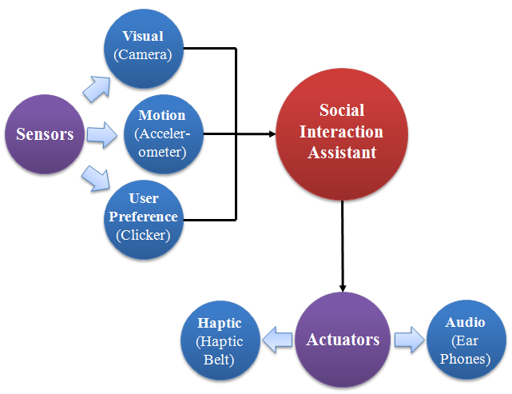
Design Considerations for Social Interaction Aid
Allow seamless and discrete embodiment of sensors
Determine both self and other’s social mannerism
Allow for long term use
Discriminate social stereotypic mannerisms from other functional movements
Be portable and wearable
Does not obstruct user’s abilities

Slide 12
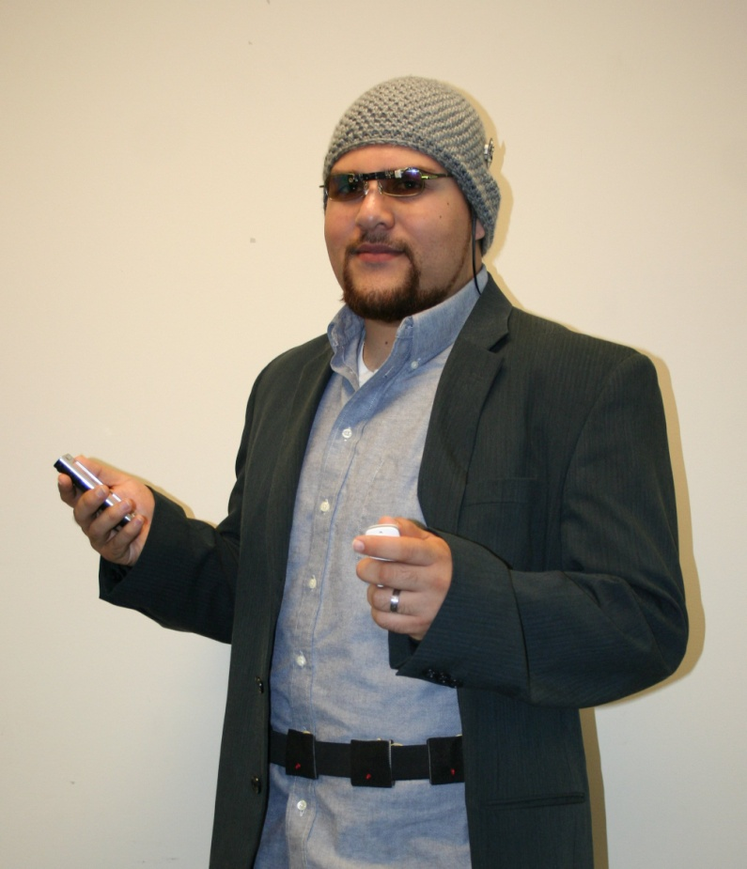
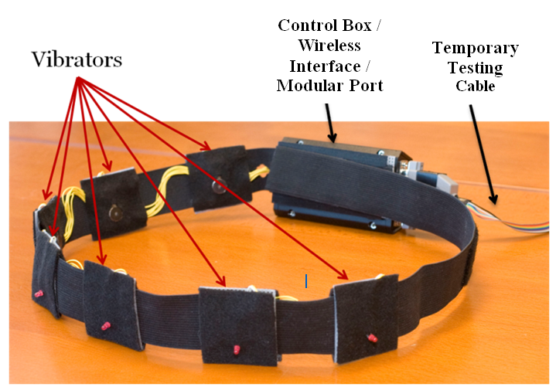
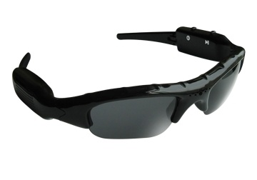
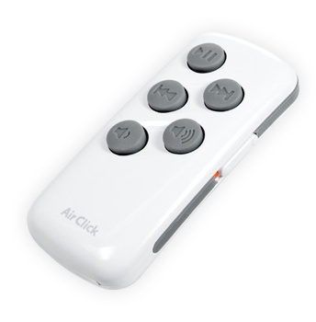
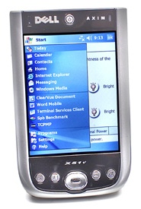
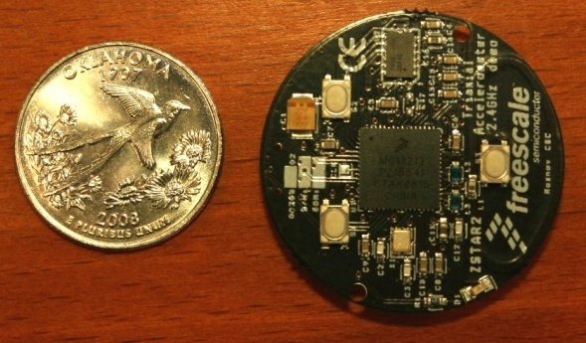
Social Interaction Assistant
Seamless and Discrete
Self and Other sensing
Long term us
Portable and wearable
No Obstructions
Miniature Motion Sensors
User Interface
Wearable Camera
PDA
Haptic Belt

Slide 13
Stereotypic Body Mannerism
Stereotypic mannerism
Facial mannerisms
Body mannerisms
Identity
Proxemics
Gaze based attention
Change in physical attributes
Physical attributes
8
8
7
6
6
7
5
3
4
1
3
2
2
5
1
4
Feasibility
High

Slide 14
Stereotypy
Any non-functional repetitive behavior
Two main causes for stereotypy
Lack of sensory feedback
Lack of cognitive feedback
Methods of control Stereotypy
Intervention
Curtail Behavior immediately
Reward / Punishment
Self Monitoring
Do not intervene directly
Develop cognitive replacement
Body Rocking is the most prevalent stereotypy for people who are blind and visually impaired

Slide 15
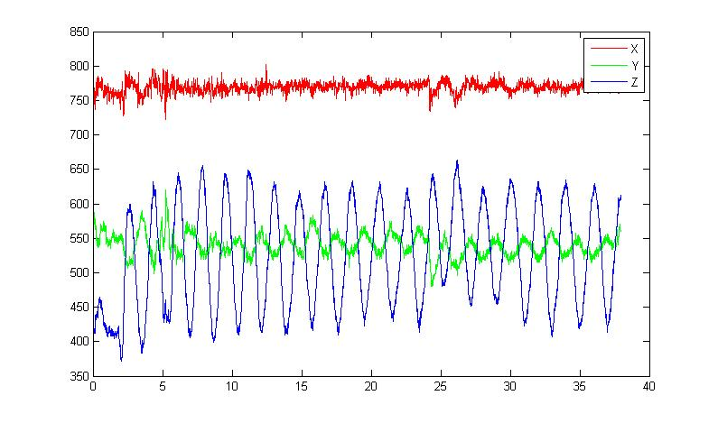
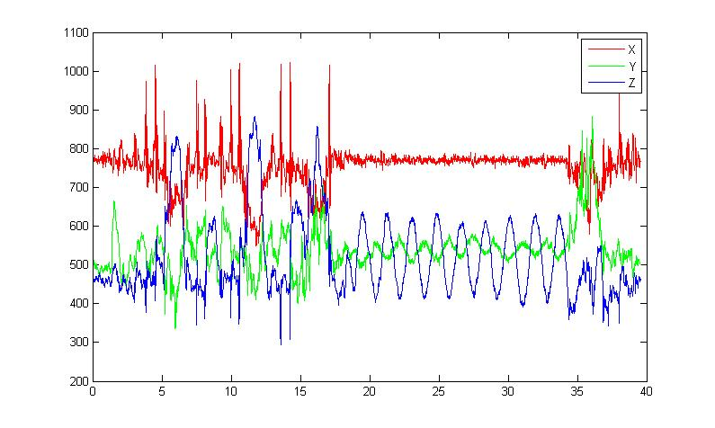
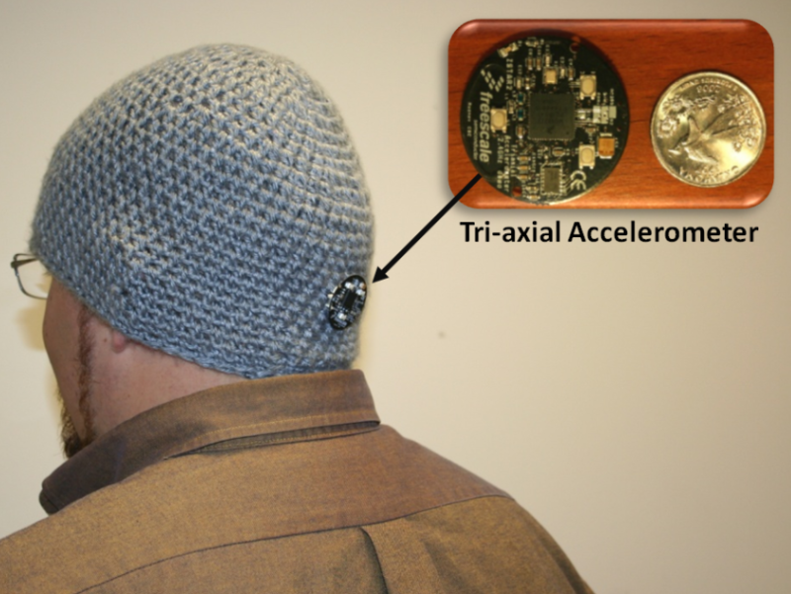
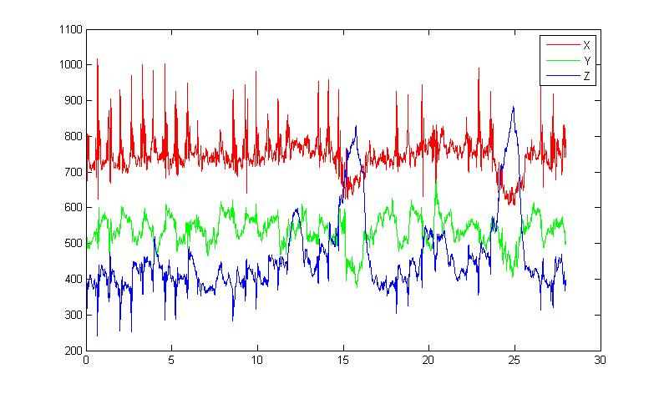
Proposed solution
Rocking
Z
Non - Rocking
Y
X
Test data

Slide 16
Features and trianing
Mean
Mean X
Mean Y
Mean Z
Mean X
Mean Y
Mean Z

Slide 17
Features and trianing
Mean
Variance
Variance of X
Variance of Y
Variance of Z
Variance X
Variance Y
Variance Z

Slide 18
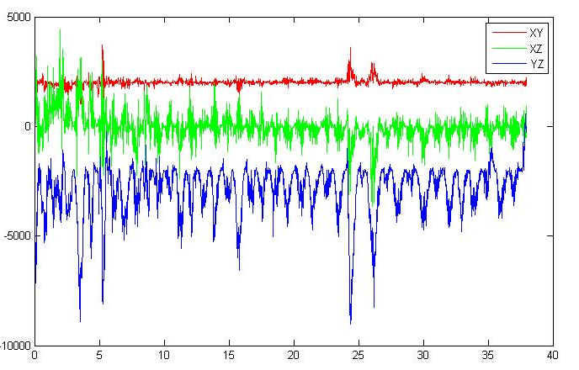
Features and trianing
Mean
Variance
Correlation between axis
Corr (X, Y)
Corr (Y, Z)
Corr (X, Z)

Slide 19
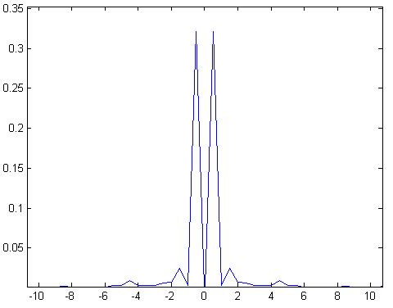
Features and trianing
Mean
Variance
Correlation between axis
Variance on FFT on Z axis
Kurtosis of FFT on Z axis
Kurtosis
Variance
Feature Vector on a time slice of input data:
Mean X
Mean Y
Mean Z
Var X
Var Y
Var Z
Corr XY
Corr XZ
Corr YZ
Var FFT Z
Kurt FFT Z

Slide 20
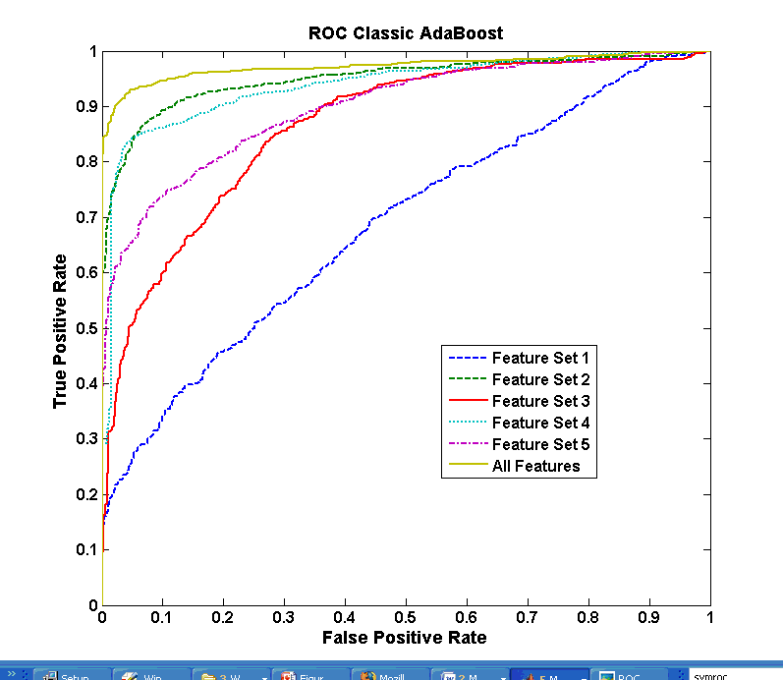
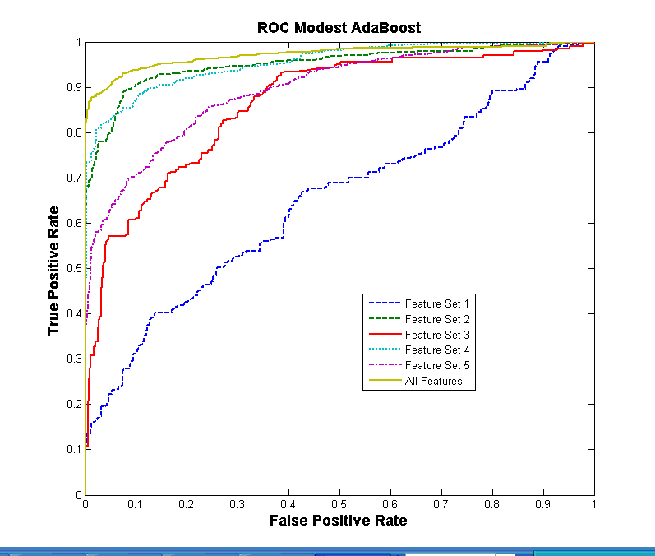
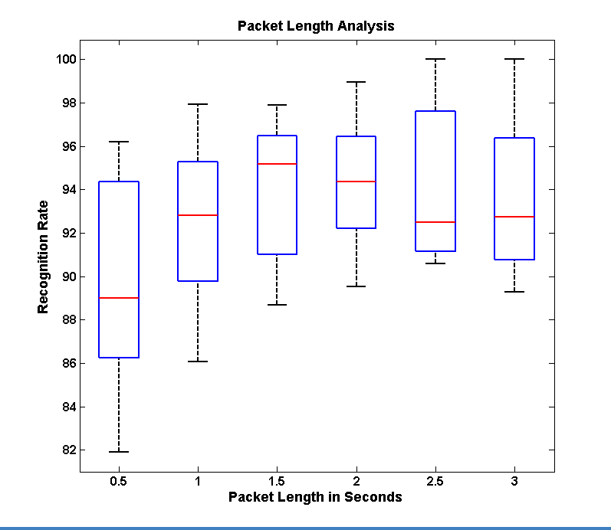
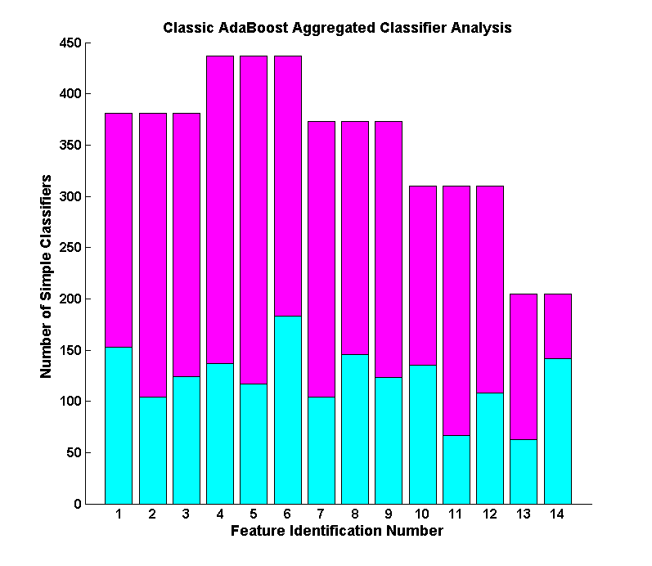
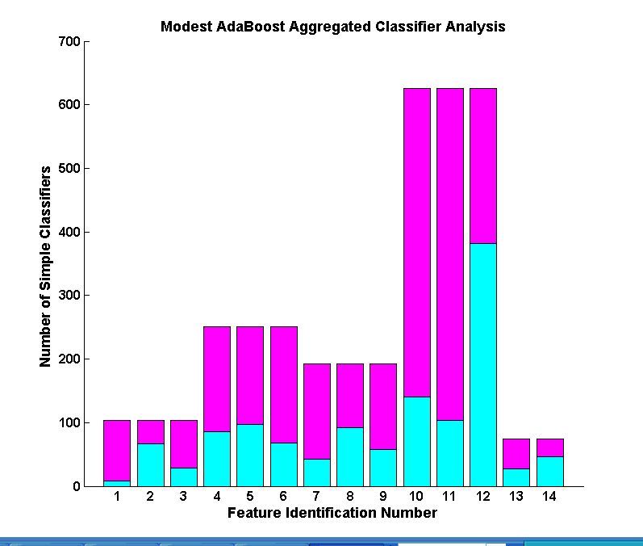
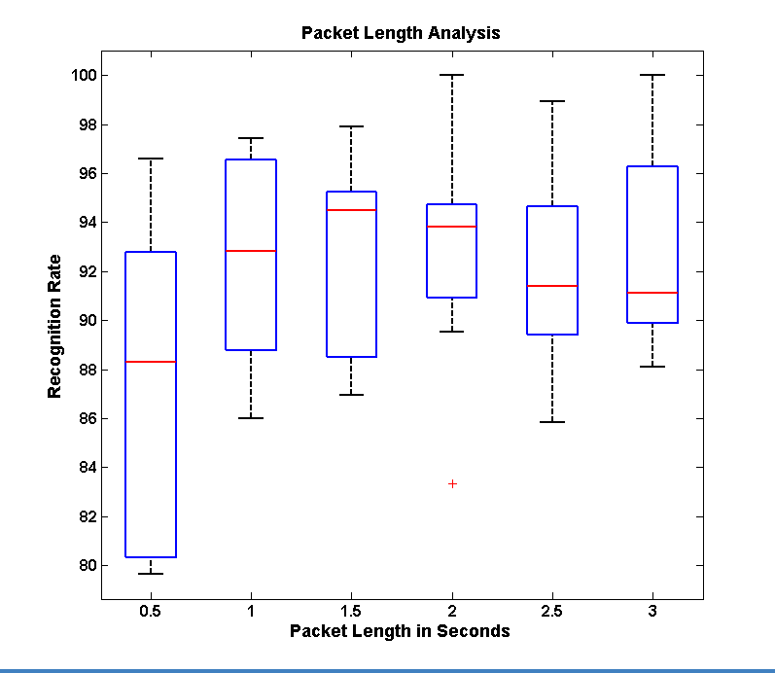
Classifiers & Results
Classic AdaBoost
Modest AdaBoost
Detection within 0.5 seconds of the start of rocking – Average rock period is 2.2 seconds.
Real-time performance on the PDA of the Social Interaction Assistant.
Feedback in audio tones and/or haptic vibrations.
Currently works like a Intervention tool, but can be extended into a self-monitoring aid.

Slide 21
Identity of the Person
Stereotypic mannerism
Facial mannerisms
Body mannerisms
Identity
Proxemics
Gaze based attention
Change in physical attributes
Physical attributes
8
8
7
6
6
7
5
3
4
1
3
2
2
5
1
4
Feasibility
High

Slide 22
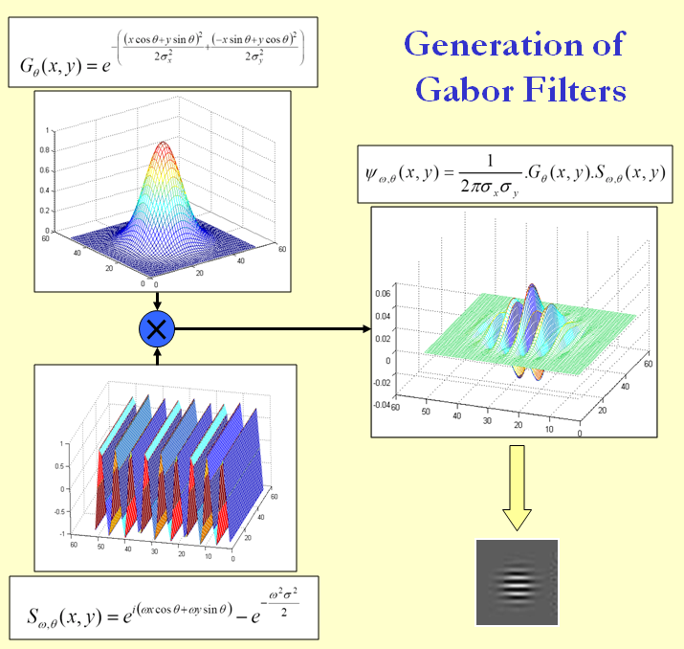
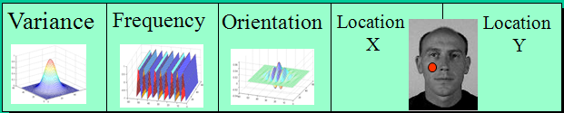
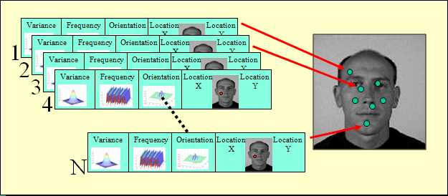
Person Specific Feature Selection
Chromosome:

Slide 23
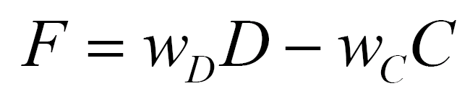
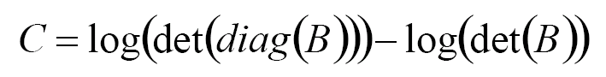
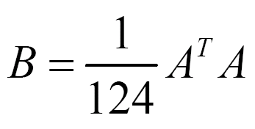
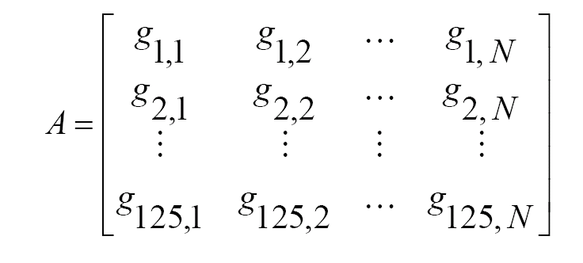
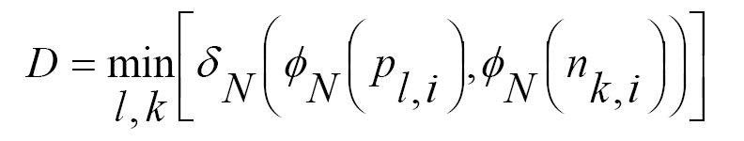
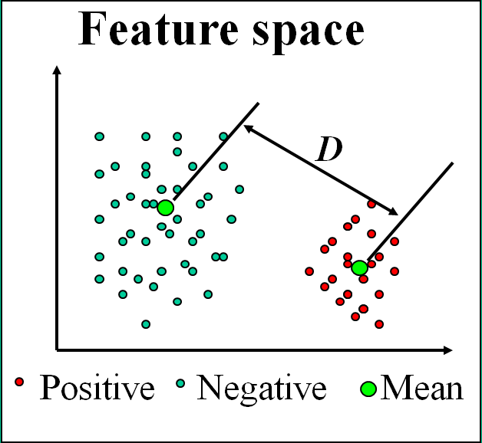
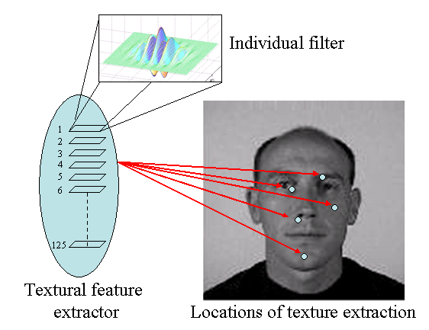
Person-Specific Feature Selection
Fitness Function:
Correlation Metric:
Distance Metric:

Slide 24
Proxemics and Gaze
Stereotypic mannerism
Facial mannerisms
Body mannerisms
Identity
Proxemics
Gaze based attention
Change in physical attributes
Physical attributes
8
8
7
6
6
7
5
3
4
1
3
2
2
5
1
4
Feasibility
High

Slide 25
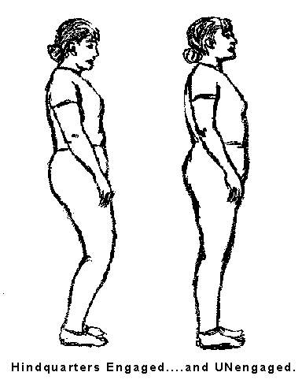
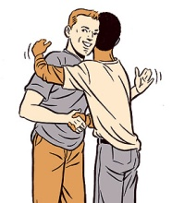
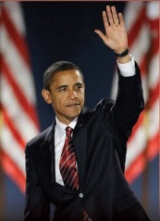


Social Gaze & Interaction Space
Interpersonal Space
0’
1.5’
4’
12’
25’
Intimate
Social
Personal
Public

Slide 26




Face/Person Detection/Tracking
Face Detection
Person Detection
Tracking
Model
Deliver

Slide 27




Modeling Distance & Direction through Face Detection
Detected Face 1
Detected Face 2
Problem with face detection algorithms
Proposed Solution

Slide 28


Module 1: Color Analysis

Slide 29







Module 2: Local Conditional Probability Density

Slide 30



Evidence Aggregation – DS Theory

Slide 31
Results
 | FERET | In-house
# actual face images | 14,051 | 2,597
# detections | 6,208 | 2,324
# true detections | 4,420 | 2,074
# false detections | 1,788 (28.8%) | 250 (10.7%)
Metric | Definition
No. of false detections (NFD) | Count of false detections
False detection rate (FDR)
Metric | Definition
Precision (P)
Capacity (C)
 | Before Validation | After Validation
NFD | 1,788 | 208
FDR | 28.8% | 3.35%
P | 0.7120 | 0.9551
C | 0.026 | 0.281
 | Before Validation | After Validation
NFD | 250 | 2
FDR | 10.7% | 0.01%
P | 0.892 | 0.999
C | 0.691 | 0.798
FERET
In-House

Slide 32


Structured Mode Searching Particle Filter (SMSPF)
Step 1
Step 2
Motivation: Weak Temporal Redundancy
Motivation:ComplexObject Structure & Abrupt Motion
Approach: Deterministic Search over a small probable search space (Histogram of Gradients with Chamfer Match)
Approach: Stochastic Search over
a large search space (Color Histogram Comparison)
Result: Approximate Estimate
Initial Estimate
Corrected Estimate
Example Search Windows
Result: Accurate Estimate

Slide 33



Results – Datasets and Evaluation Metrics
Area Overlap (AO):
Distance b.w Centroids (DC):
Tracking Evaluation Measure (Harmonic Mean of AO & DC )
Evaluation Metrics
DataSet 1 (Collected at CUbiC) : Plain Background; Static Camera; 320x240 resolution
DataSet 2 (CASIA Gait Dataset B with subject approaching the camera) : Slightly cluttered Background; Static Camera; 320x240 resolution
DataSet 3 (Collected at CUbiC) : Cluttered Background; Mobile Camera; 320x240 resolution

Slide 34











Results – Example Dataset
#2
#40
#2
#40
Color PF
SMSPF
Clear improvement in tracking results when compared with Numiaro’s Color based particle filtering
Area Overlap Ratio
Distance between Centroids

Slide 35


Delivery of Proxemics and Gaze
Haptic Belt 2
Haptic Belt 1

Slide 36




Distance & Direction Information Delivery

Slide 37
Proposed Work
Stereotypic mannerism
Facial mannerisms
Body mannerisms
Identity
Proxemics
Gaze based attention
Change in physical attributes
Physical attributes
8
8
7
6
6
7
5
3
4
1
3
2
2
5
1
4
Feasibility
High

Slide 38




Facial Expressions and Head Mannerisms
Facial Feature Tracking
Line Segment Features
Head Tracking and Registration

Slide 39





Vibro-tactile Glove
Motor Driver
Micro Controller
USB Serial Interface

Slide 40

Mapping of Basic Expressions

Slide 41




Initial Results

Slide 42
Future Work
Stereotypic mannerism
Facial mannerisms
Body mannerisms
Identity
Proxemics
Gaze based attention
Change in physical attributes
Physical attributes
8
8
7
6
6
7
5
3
4
1
3
2
2
5
1
4
Feasibility
High

Slide 43


Conveying Body Mannerisms
Enactor
Body Posture
Body Gestures
Social Mirror
Social Interaction Assistant
Recipient

Slide 44
Computational Model
Design & Engineering
Sensor & Actuator Technologies
Human Computer Interaction
Social, Behavioral & Personal Dynamics
SIA
Modeling & Simulation
Abstract Interaction
Machine Learning and Pattern Recognition
Socio-Behavioral Computing

Slide 45



HCI vs Proposed System
Modeling Interpersonal dynamics.
Efficient models for sense and delivery of vital social signals.
“Honest Signals” and their implications in assistive technology solutions.
Atomic level modeling of human interaction for building better Computational Social Systems.
Graphical Models for interpersonal dynamics.
Machine Learning for real-time user interface adaptation.
Optimization of social signal importance maps with user interface confusion matrix.
Combining evidence from various body and face cues towards efficient social signal interpretation.
Human
Machine
HCI
Mediation
Human
SIA
Human

Slide 46
Impact - Publications
Requirements Analysis & System Design
Body Rocking
Identity
S. Krishna, D. Colbry, J. Black, V. Balasubramanian, and S. Panchanathan, “A Systematic Requirements Analysis and Development of an Assistive Device to Enhance the Social Interaction of People Who are Blind or Visually Impaired,” Marseille, France: 2008.
S. Krishna, N.C. Krishnan, and S. Panchanathan, “Detecting Stereotype Body Rocking Behavior through Embodied Motion Sensors,” New Orleans, LA: 2009.
S. Krishna and S. Panchanathan, “Embodied Social Interaction Assistant”, Technical Report, April 2009.
S. Panchanthan, N.C. Krishnan, S. Krishna, T. McDaniel, and V.N. Balasubramanian, “Enriched human-centered multimedia computing through inspirations from disabilities and deficit-centered computing solutions,” Proceeding of the 3rd ACM international workshop on Human-centered computing, Vancouver, British Columbia, Canada: ACM, 2008, pp. 35-42.
S. Panchanathan, S. Krishna, J. Black, and V. Balasubramanian, “Human Centered Multimedia Computing: A New Paradigm for the Design of Assistive and Rehabilitative Environments,” Signal Processing, Communications and Networking, 2008. ICSCN '08. International Conference on, 2008, pp. 1-7.
S. Krishna and S. Panchanathan, “On the detection of streotypic body mannerisms using embodied motion sensors,” Journal of Multimedia Submitted, Nov. 2009.
S. Krishna, V. Balasubramanian, J. Black, and S. Panchanathan, “Person-Speciﬁc Characteristic Feature Selection for Face Recognition.,” Biometrics: Theory, Methods, and Applications (IEEE Press Series on Computational Intelligence), N.V. Boulgoris, ed., Wiley-IEEE Press, 2009.
S. Krishna, J. Black, and S. Panchanathan, “Using Genetic Algorithms to Find Person-Specific Gabor Feature Detectors for Face Indexing and Recognition,” Advances in Biometrics, 2006, pp. 182-191.

Slide 47
Impact – Publications Contd.
Proxemics
Facial Expression
T. McDaniel, S. Krishna, V. Balasubramanian, D. Colbry, and S. Panchanathan, “Using a haptic belt to convey non-verbal communication cues during social interactions to individuals who are blind,” Haptic Audio visual Environments and Games, 2008. HAVE 2008. IEEE International Workshop on, 2008, pp. 13-18.
T.L. McDaniel, S. Krishna, D. Colbry, and S. Panchanathan, “Using tactile rhythm to convey interpersonal distances to individuals who are blind,” Proceedings of the 27th international conference extended abstracts on Human factors in computing systems, Boston, MA, USA: ACM, 2009, pp. 4669-4674.
S. Krishna and S. Panchanathan, “Combining Skin-Color Detector and Evidence Aggregated Random Field Models towards Validating Face Detection Results,” Computer Vision, Graphics & Image Processing, 2008. ICVGIP '08. Sixth Indian Conference on, 2008, pp. 466-473.
N. Edwards, J. Rosenthal, D. Molbery, J. Lindsey, K. Blair, T. McDaniel, S. Krishna, and S. Panchanathan, “A Pragmatic Approach to the Design and Implementation of a Vibrotactile Belt and its Applications,” Italy: 2009.
L. Gade, S. Krishna, and S. Panchanathan, “Person Localization In A Wearable Camera Platform Towards Assistive Technology For Social Interactions,” Media Solutions that Improve Accessibility to Disabled Users, 2009.
L. Gade, S. Krishna, and S. Panchanathan, “Person localization using a wearable camera towards enhancing social interactions for individuals with visual impairment,” Proceedings of the 1st ACM SIGMM international workshop on Media studies and implementations that help improving access to disabled users, Beijing, China: ACM, 2009, pp. 53-62.
S. Krishna, T. McDaniel, and S. Panchanathan, “Haptic Belt for Delivering Nonverbal Communication Cues to People who are Blind or Visually Impaired,” 25th Annual International Technology & Persons with Disabilities Conference, Los Angeles, CA: 25, 2009.
S. Krishna, S. Bala, T. McDaniel, S. McGuire and S. Panchanathan, “Vibrotactile belt – Enabling access to facial mannerisms for people who are blind”, 26th Annual International Technology & Persons with Disabilities Conference, San Diego, CA, 2010.

Slide 48
Impact - Outreach
Capstone Projects
2007 – Social Interaction Assistant
Fulton Undergraduate Research Initiative (FURI)
2007/08 – Social Interaction Assistant -Daniel Merrill
2009 – Wireless Haptic Belt
2009 – Project Steven
2009 – Panoramic Camera for Extended Situational Awareness
2008 – Facial Expressions Recognition using AAM - Colin Juillard
2009 – Social Interaction Assistant Data Collection Unit - Kevin McMillan
High School STEM
2009 – Vibrotactile Glove Project - Shantanu Bala
2006 – FacePix Data Collection - Sonjeev

Slide 49
Impact – Funding Activities
Broad Area Announcement – Office of Naval Research
HANSCOM AFB
Oct 2009 – Oct 2010
Haptic Annunciator System – Haptic Belt
GPSA GPRS Award
2009

Slide 50
Time Line
 | Dec | Jan | Feb | Mar | April | May
Real-time extraction of crucial facial feature movements | Χ | Χ | Χ
Mapping of categorical facial expressions | Χ | Χ
Mapping of dynamic facial movements |  | Χ | Χ | Χ
User testing – Sighted and Visually Impaired |  | Χ | Χ | Χ | Χ
Publication | Χ | Χ | Χ | Χ | Χ | Χ
Defense |  |  |  |  |  | Χ

Slide 51
Thanks
System Analysis and Design
Dr. Dirk Colbry
Body Rocking
Narayanan CK
Dr. Terri Hedgpeth
Dr. John Black
Proxemics
Troy McDaniel
Jacob Rosenthal
Nathan Edwards
Lakshmi Gade
Facial Expression
Stephen McGuire
Shantanu Bala
Dr. Michelle Shiota
Social Interaction Assistant
Dr. Panch
Dr. John Black
Identity of the person
Vineeth Balasumbramanian
Dr. John Black
Greg Little
Michael Astrauskas

